Slide 1

Apex Institute of Technology
Department of Computer Science & Engineering
Data Mining and Warehousing
(CSF-334)
Dr Neha Agarwal
E11231
Assistant Professor
CSE(AIT), CU
DISCOVER . LEARN . EMPOWER

Slide 2
Contents to be Covered
Hierarchical Clustering
Density based clustering

Slide 3
Hierarchical Clustering
Use distance matrix as clustering criteria. This method does not require the number of clusters k as an input, but needs a termination condition
Step 0
Step 1
Step 2
Step 3
Step 4
agglomerative
(AGNES)
a
a b
b
a b c d e
c
c d e
d
d e
e
divisive
(DIANA)
Step 4
Step 3
Step 2
Step 1
Step 0

Slide 4
AGNES (Agglomerative Nesting)
Introduced in Kaufmann and Rousseeuw (1990)
Implemented in statistical analysis packages, e.g., Splus
Use the Single-Link method and the dissimilarity matrix.
Merge nodes that have the least dissimilarity
Go on in a non-descending fashion
Eventually all nodes belong to the same cluster

Slide 5
Dendrogram: Shows How the Clusters are Merged
Decompose data objects into a several levels of nested partitioning (tree of clusters), called a dendrogram.
A clustering of the data objects is obtained by cutting the dendrogram at the desired level, then each connected component forms a cluster.

Slide 6
DIANA (Divisive Analysis)
Introduced in Kaufmann and Rousseeuw (1990)
Implemented in statistical analysis packages, e.g., Splus
Inverse order of AGNES
Eventually each node forms a cluster on its own

Slide 7
Recent Hierarchical Clustering Methods
Major weakness of agglomerative clustering methods
do not scale well: time complexity of at least O(n²), where n is the number of total objects
can never undo what was done previously
Integration of hierarchical with distance-based clustering
BIRCH (1996): uses CF-tree and incrementally adjusts the quality of sub-clusters
ROCK (1999): clustering categorical data by neighbor and link analysis
CHAMELEON (1999): hierarchical clustering using dynamic modeling

Slide 8
BIRCH (1996)
Birch: Balanced Iterative Reducing and Clustering using Hierarchies (Zhang, Ramakrishnan & Livny, SIGMOD’96)
Incrementally construct a CF (Clustering Feature) tree, a hierarchical data structure for multiphase clustering
Phase 1: scan DB to build an initial in-memory CF tree (a multi-level compression of the data that tries to preserve the inherent clustering structure of the data)
Phase 2: use an arbitrary clustering algorithm to cluster the leaf nodes of the CF-tree
Scales linearly: finds a good clustering with a single scan and improves the quality with a few additional scans
Weakness: handles only numeric data, and sensitive to the order of the data record.

Slide 9
Clustering Feature Vector in BIRCH
Clustering Feature: CF = (N, LS, SS)
N: Number of data points
LS: ∑^{N}_{i=1}=X_{i}
SS: ∑^{N}_{i=1}=X_{i}²
CF = (5, (16,30),(54,190))
(3,4)
(2,6)
(4,5)
(4,7)
(3,8)

Slide 10
CF-Tree in BIRCH
Clustering feature:
summary of the statistics for a given subcluster: the 0-th, 1st and 2nd moments of the subcluster from the statistical point of view.
registers crucial measurements for computing cluster and utilizes storage efficiently
A CF tree is a height-balanced tree that stores the clustering features for a hierarchical clustering
A nonleaf node in a tree has descendants or “children”
The nonleaf nodes store sums of the CFs of their children
A CF tree has two parameters
Branching factor: specify the maximum number of children.
threshold: max diameter of sub-clusters stored at the leaf nodes

Slide 11
The CF Tree Structure
Root
B = 7
L = 6
CF₁
CF₂
CF₃
CF₆
child₁
child₂
child₃
child₆
Non-leaf node
CF₁
CF₂
CF₃
CF₅
child₁
child₂
child₃
child₅
Leaf node
Leaf node
prev
CF₁
CF₂
CF₆
next
prev
CF₁
CF₂
CF₄
next

Slide 12
Clustering Categorical Data: The ROCK Algorithm
ROCK: RObust Clustering using linKs
S. Guha, R. Rastogi & K. Shim, ICDE’99
Major ideas
Use links to measure similarity/proximity
Not distance-based
Computational complexity:
Algorithm: sampling-based clustering
Draw random sample
Cluster with links
Label data in disk
Experiments
Congressional voting, mushroom data

Slide 13
Similarity Measure in ROCK
Traditional measures for categorical data may not work well, e.g., Jaccard coefficient
Example: Two groups (clusters) of transactions
C₁. <a, b, c, d, e>: {a, b, c}, {a, b, d}, {a, b, e}, {a, c, d}, {a, c, e}, {a, d, e}, {b, c, d}, {b, c, e}, {b, d, e}, {c, d, e}
C₂. <a, b, f, g>: {a, b, f}, {a, b, g}, {a, f, g}, {b, f, g}
Jaccard co-efficient may lead to wrong clustering result
C₁: 0.2 ({a, b, c}, {b, d, e}} to 0.5 ({a, b, c}, {a, b, d})
C₁ & C₂: could be as high as 0.5 ({a, b, c}, {a, b, f})
Jaccard co-efficient-based similarity function:
Ex. Let T₁ = {a, b, c}, T₂ = {c, d, e}

Slide 14
Link Measure in ROCK
Links: # of common neighbors
C₁ <a, b, c, d, e>: {a, b, c}, {a, b, d}, {a, b, e}, {a, c, d}, {a, c, e}, {a, d, e}, {b, c, d}, {b, c, e}, {b, d, e}, {c, d, e}
C₂ <a, b, f, g>: {a, b, f}, {a, b, g}, {a, f, g}, {b, f, g}
Let T₁ = {a, b, c}, T₂ = {c, d, e}, T₃ = {a, b, f}
link(T_{1,} T₂) = 4, since they have 4 common neighbors
{a, c, d}, {a, c, e}, {b, c, d}, {b, c, e}
link(T_{1,} T₃) = 3, since they have 3 common neighbors
{a, b, d}, {a, b, e}, {a, b, g}
Thus link is a better measure than Jaccard coefficient

Slide 15
CHAMELEON: Hierarchical Clustering Using Dynamic Modeling (1999)
CHAMELEON: by G. Karypis, E.H. Han, and V. Kumar’99
Measures the similarity based on a dynamic model
Two clusters are merged only if the interconnectivity and closeness (proximity) between two clusters are high relative to the internal interconnectivity of the clusters and closeness of items within the clusters
Cure ignores information about interconnectivity of the objects, Rock ignores information about the closeness of two clusters
A two-phase algorithm
Use a graph partitioning algorithm: cluster objects into a large number of relatively small sub-clusters
Use an agglomerative hierarchical clustering algorithm: find the genuine clusters by repeatedly combining these sub-clusters

Slide 16
Overall Framework of CHAMELEON
Construct
Sparse Graph
Partition the Graph
Data Set
Merge Partition
Final Clusters

Slide 17
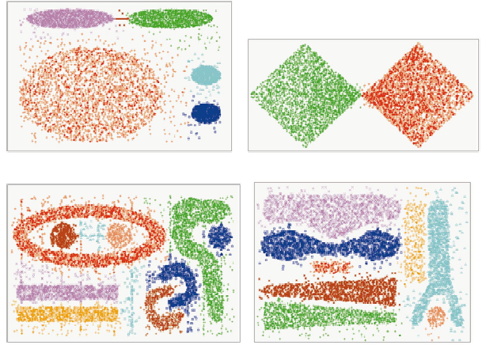
CHAMELEON (Clustering Complex Objects)

Slide 18
Density-Based Clustering Methods
Clustering based on density (local cluster criterion), such as density-connected points
Major features:
Discover clusters of arbitrary shape
Handle noise
One scan
Need density parameters as termination condition
Several interesting studies:
DBSCAN: Ester, et al. (KDD’96)
OPTICS: Ankerst, et al (SIGMOD’99).
DENCLUE: Hinneburg & D. Keim (KDD’98)
CLIQUE: Agrawal, et al. (SIGMOD’98) (more grid-based)

Slide 19
Density-Based Clustering: Basic Concepts
Two parameters:
Eps: Maximum radius of the neighbourhood
MinPts: Minimum number of points in an Eps-neighbourhood of that point
N_{Eps}(p): {q belongs to D | dist(p,q) <= Eps}
Directly density-reachable: A point p is directly density-reachable from a point q w.r.t. Eps, MinPts if
p belongs to N_{Eps}(q)
core point condition:
|N_{Eps} (q)| >= MinPts
p
MinPts = 5
Eps = 1 cm
q

Slide 20
Density-Reachable and Density-Connected
Density-reachable:
A point p is density-reachable from a point q w.r.t. Eps, MinPts if there is a chain of points p₁, …, p_{n}, p₁ = q, p_{n} = p such that p_{i+1} is directly density-reachable from p_{i}
Density-connected
A point p is density-connected to a point q w.r.t. Eps, MinPts if there is a point o such that both, p and q are density-reachable from o w.r.t. Eps and MinPts
p
p₁
q
p
q
o

Slide 21
DBSCAN: Density Based Spatial Clustering of Applications with Noise
Relies on a density-based notion of cluster: A cluster is defined as a maximal set of density-connected points
Discovers clusters of arbitrary shape in spatial databases with noise
Outlier
Border
Eps = 1cm
MinPts = 5
Core

Slide 22
DBSCAN: The Algorithm
Arbitrary select a point p
Retrieve all points density-reachable from p w.r.t. Eps and MinPts.
If p is a core point, a cluster is formed.
If p is a border point, no points are density-reachable from p and DBSCAN visits the next point of the database.
Continue the process until all of the points have been processed.

Slide 23
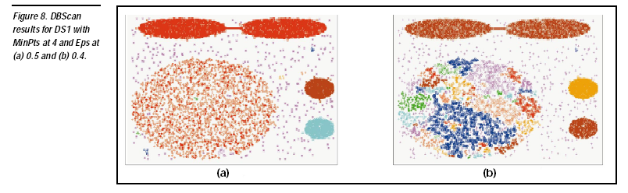

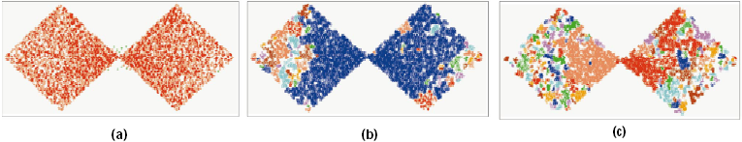
DBSCAN: Sensitive to Parameters

Slide 24
CHAMELEON (Clustering Complex Objects)

Slide 25
OPTICS: A Cluster-Ordering Method (1999)
OPTICS: Ordering Points To Identify the Clustering Structure
Ankerst, Breunig, Kriegel, and Sander (SIGMOD’99)
Produces a special order of the database wrt its density-based clustering structure
This cluster-ordering contains info equiv to the density-based clusterings corresponding to a broad range of parameter settings
Good for both automatic and interactive cluster analysis, including finding intrinsic clustering structure
Can be represented graphically or using visualization techniques

Slide 26
OPTICS: Some Extension from DBSCAN
Index-based:
k = number of dimensions
N = 20
p = 75%
M = N(1-p) = 5
Complexity: O(kN²)
Core Distance
Reachability Distance
D
p1
o
p2
o
Max (core-distance (o), d (o, p))
r(p1, o) = 2.8cm. r(p2,o) = 4cm
MinPts = 5
ε = 3 cm

Slide 27
Reachability-distance
undefined
‘
Cluster-order
of the objects

Slide 28
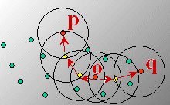
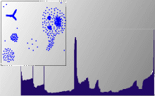
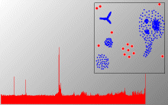
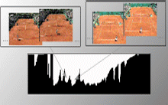
Density-Based Clustering: OPTICS & Its Applications

Slide 29
DENCLUE: Using Statistical Density Functions
DENsity-based CLUstEring by Hinneburg & Keim (KDD’98)
Using statistical density functions:
Major features
Solid mathematical foundation
Good for data sets with large amounts of noise
Allows a compact mathematical description of arbitrarily shaped clusters in high-dimensional data sets
Significant faster than existing algorithm (e.g., DBSCAN)
But needs a large number of parameters

Slide 30
Denclue: Technical Essence
Uses grid cells but only keeps information about grid cells that do actually contain data points and manages these cells in a tree-based access structure
Influence function: describes the impact of a data point within its neighborhood
Overall density of the data space can be calculated as the sum of the influence function of all data points
Clusters can be determined mathematically by identifying density attractors
Density attractors are local maximal of the overall density function

Slide 31
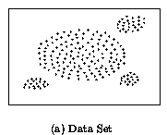
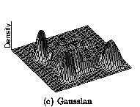
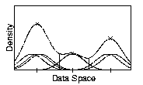
Density Attractor

Slide 32
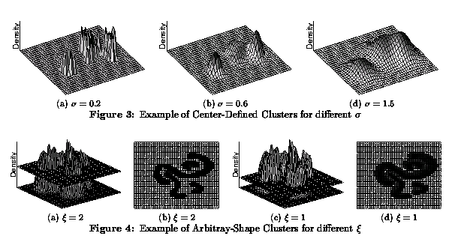
Center-Defined and Arbitrary

Slide 33
Homework
Discuss the concept of DBSCAN.
Discuss the concept of Agglomerative clustering.

Slide 34
References
TEXT BOOKS
Introduction to Data Mining, Tan, Steinbach and Vipin Kumar, Pearson Education, 2016
REFERENCE BOOKS
Data Mining: Concepts and Techniques, Pei, Han and Kamber, Elsevier (2nd edition)
Journals
https://www.sciencedirect.com/science/article/pii/B9780323857086000084

Slide 35
Thank you
Please Send Your Queries on:
e-Mail: neha.e11231@cumail.in

